Slide 1
100% Decarbonization of the Electricity Sector: Impacts on Wholesale Electricity Markets
Paul L. Joskow
MIT
March 13, 2020
Draws on preliminary research for the MIT Energy Storage Project: P. Joskow, R. Schmalensee, H. Gruenspecht,
P. Brown, D. Mallapragada, Cristian Junge, and Cathy Wang

Slide 2
Very Low Stress Operation, MC = 0
SRMC, $/MW
Grid demand
Max VER Output
power to storage
= Max Charge
Curtailment
MW

Slide 3
Low Stress Operation, MC = μ(charge)
Max VER Output
SRMC, $/MW
Grid demand
power to storage,
< Max Charge
μ(charge)
MW

Slide 4
Storage Operation, MC = μ(discharge)
SRMC, $/MW
Max VER Output
Grid Demand
μ(discharge)
power from storage
< Max Discharge
MW

Slide 5
Very High Stress Operation, MC = VLL
Max VER Output
Lost Load
Final Demand
SRMC, $/MW
VoLL
power from storage
= Max Discharge
MW

Slide 6
Very High Stress Equilbrium, P = P_{MAX} with ORDC
MC, $/MW
Max VER Output
Lost Load
VoLL
P_{MAX}
Final Demand
SRMC+ORDC
=SRMC*
μ(discharge)
power from storage
= Max Discharge
MW

Slide 7
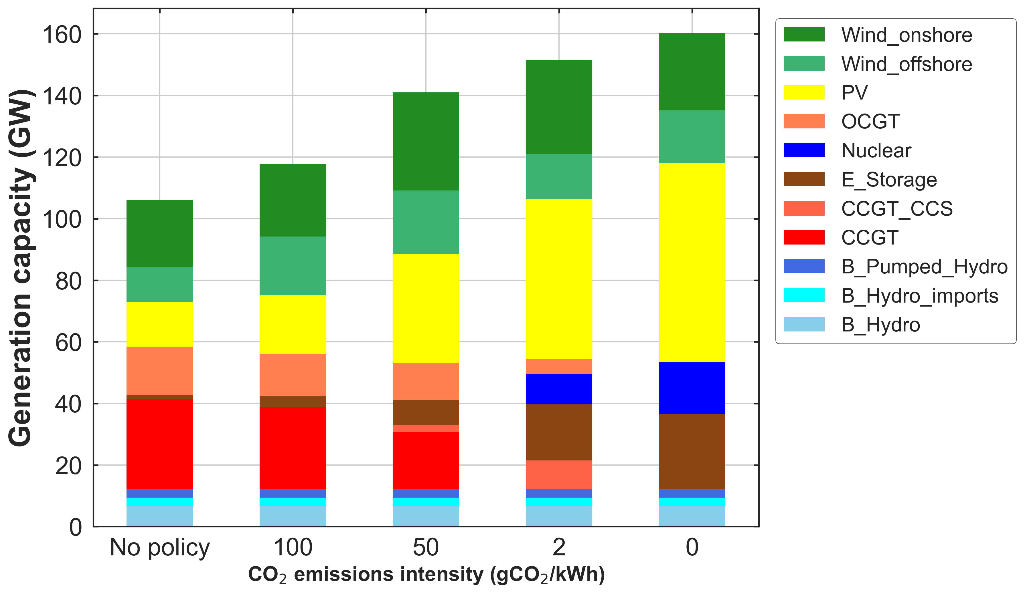
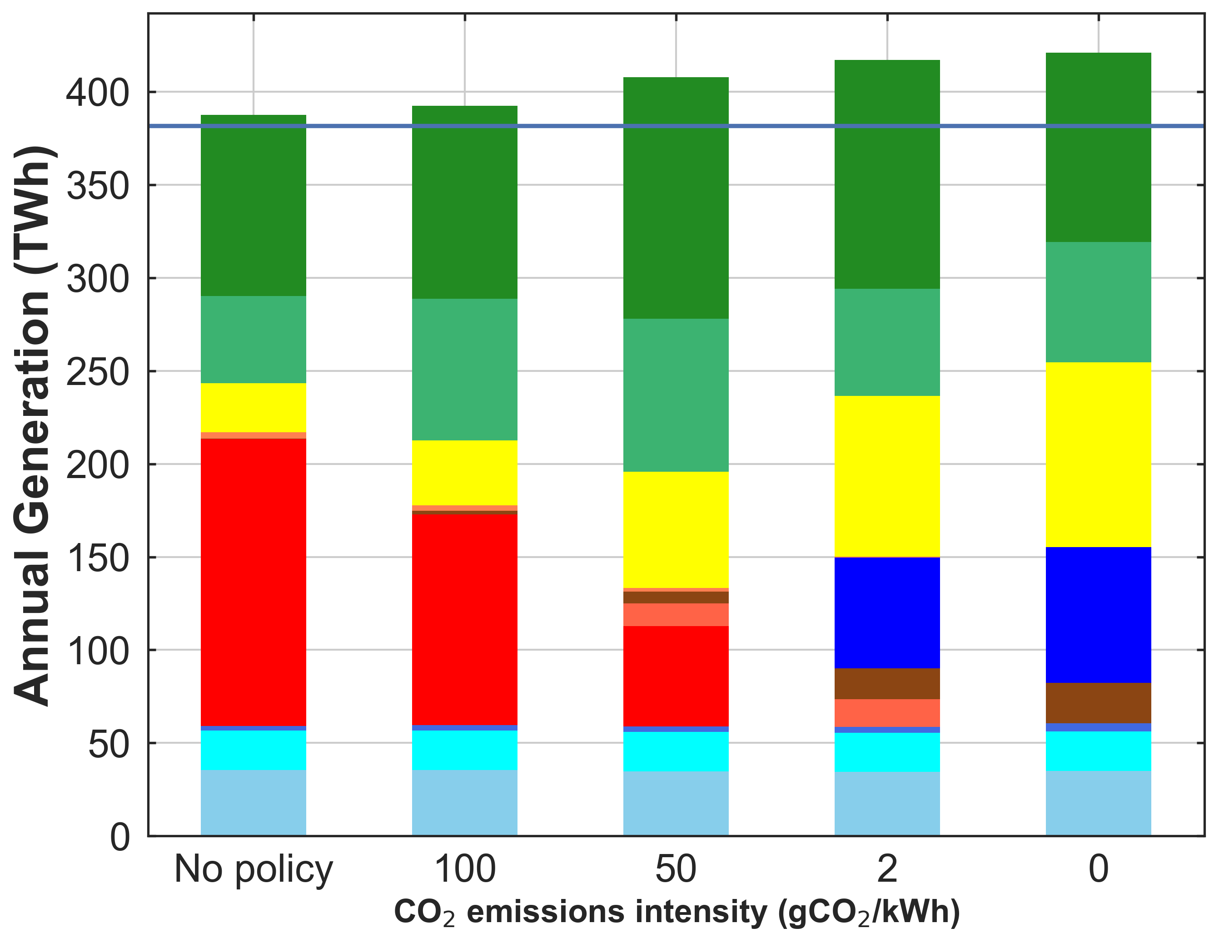
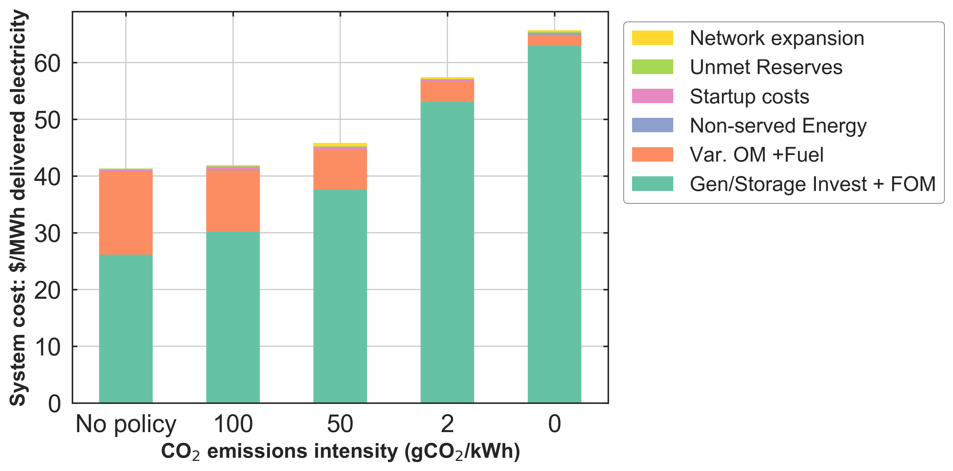
2050 greenfield scenario for NY+NE – unconstrained (no policy) emissions scenario vs. scenarios of decreasing emissions intensity requirements
Installed capacity
Annual generation
65.7
System cost trends
57.4
Emissions intensity of no policy scenario = 134 gCO2/kWh
CCGT with CCS ineligible for 0gCO2/kWh case due to 90% CO2 capture at power plant
System outcomes without CO2 emissions cap = 133 gCO₂/kWh and 44% VRE penetration
Notes:
Key findings – 1) Storage approaches 33% of peak demand by zero emissions scenario, role of nuclear grows in the system; 2) Storage duration approaches 6 hours and not more - Low duration due to availability of pumped hydro (8 hours), dispatchable generation (Hydro) and high costs of batteries; 3) Generation from storage comparable to generation from Hydro
No policy solution gets you to 133gCO2/kWh; VRE penetration of 44%;
Flip the x-axis on bottom plot; to be able to show the effect of smoothing -
losses reflect transmission losses and energy storage round trip efficiency; model hitting capacity limits for the best wind sites and solar sites in case of urban areas

Slide 8
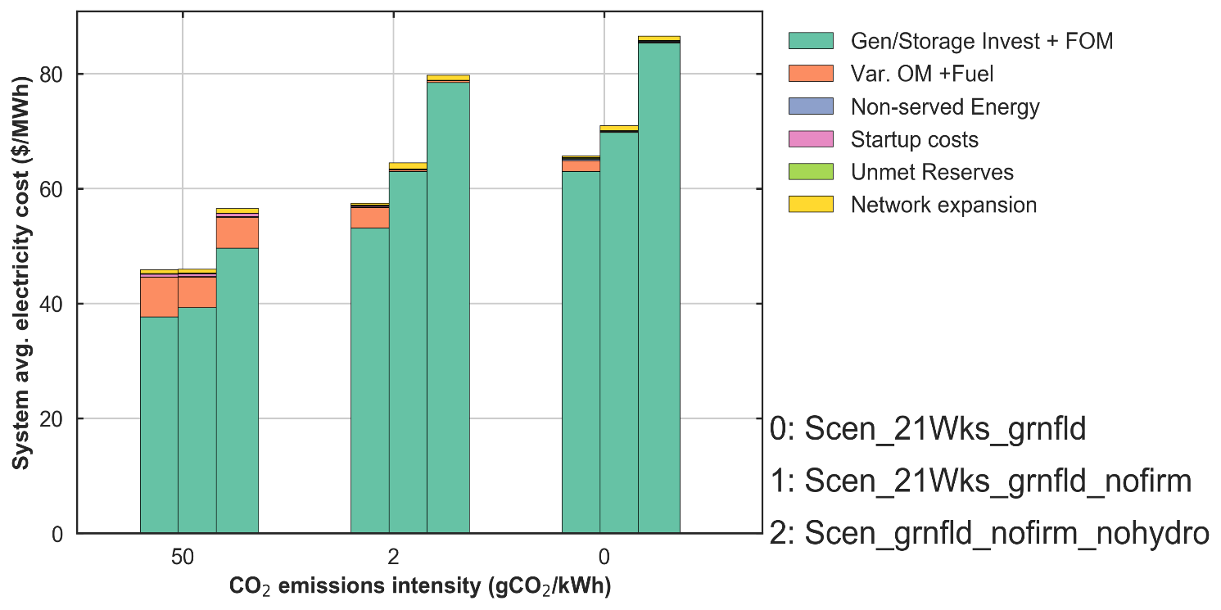
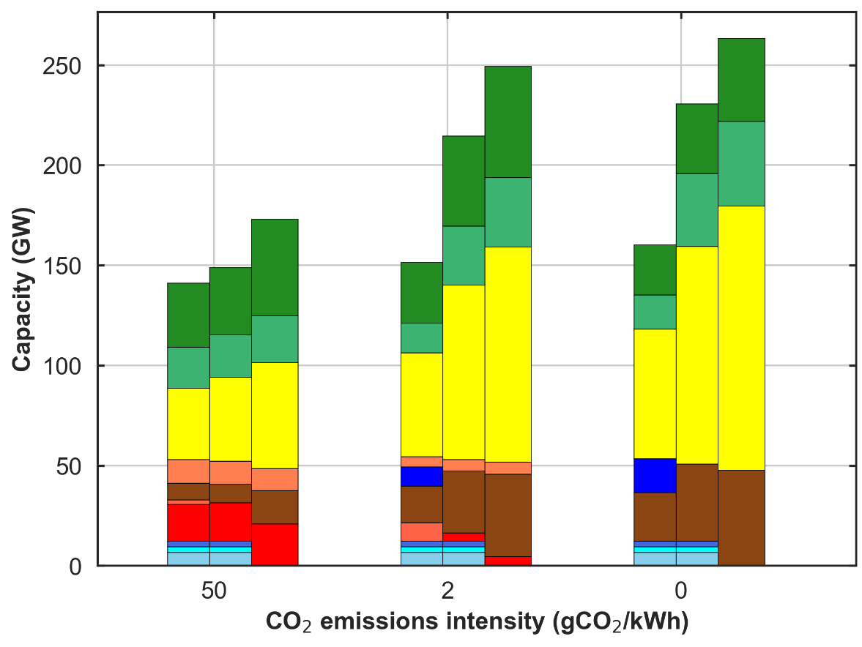
2050 Greenfield Scenario for NY + NE: Without dispatchable hydro, nuclear, CCGT-CCS
System avg. cost of electricity
Capacity trends
No nuclear or CCS + no hydro
No nuclear or CCS + no hydro
No nuclear or CCS
No nuclear or CCS
Base
Base
EI0 Storage impacts from nuclear, CCS and hydro availability
VRE curtailment | Base case | No nuclear, CCS or hydro
VRE curtailment | 5 | 22
Energy to Power ratio (hours) | 6 | 10
Storage % of total generation | 6% | 11%
Storage cycles¹ | 140 | 85
Notes:
What is the lost load and lost reserves in both cases
Highlight storage specific outcomes for 0g CO2/kWh, charge, discharge trends, hours of zero operation etc. contribution to reserves
Check loss of load condition here

Slide 9
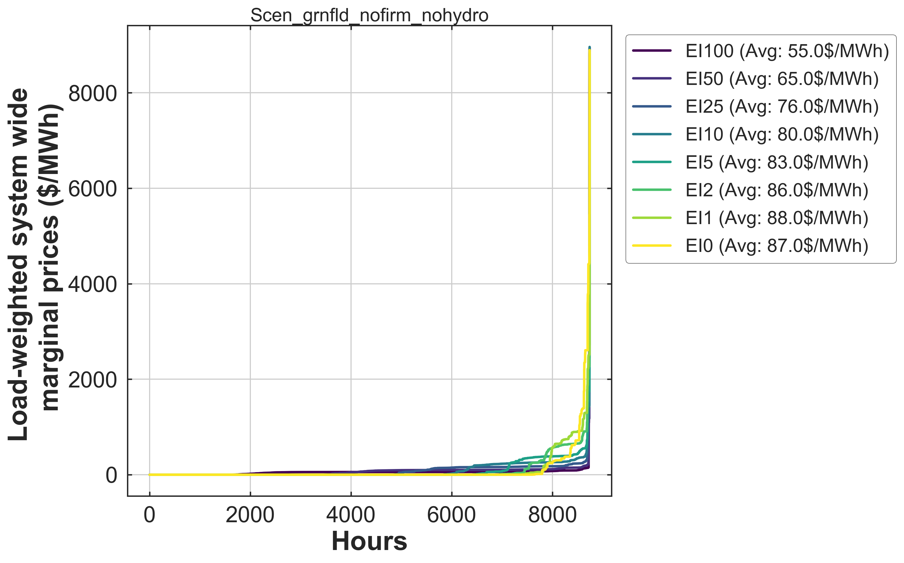
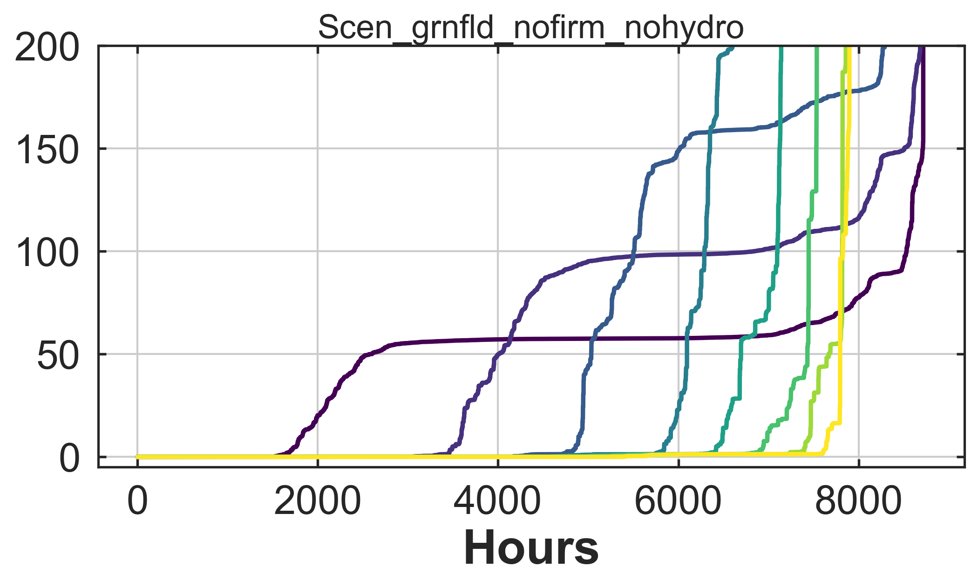
2050 Greenfield Scenario: Without dispatchable hydro, nuclear, CCGT-CCS
Constraint | Number of hours with
 | Price<$2/MWh | Price> $1000/MWh
EI100 | 1656 | 18
EI50 | 3460 | 18
EI25 | 4752 | 30
EI10 | 5759 | 40
EI5 | 6356 | 43
EI2 | 6847 | 141
EI0 | 7601 | 205

